Slide 1

Excel Mastery: Automating the Modern Workflow
Sprint 6 — Practical Formula Applications for Employee Performance, Sales Tracking, Attendance Monitoring & Automated Decision-Making

Slide 2

The Hidden Cost of Manual Tracking
⚠️ Data Entry Fatigue
⏳ Lost Hours
Manual input leads to critical errors that compound over time, undermining report accuracy and decision quality.
The average analyst spends 30% of their time on manual formatting instead of analysis and strategy.
🎯 The Goal
Transition from reactive record-keeping to proactive, automated insight generation.

Slide 3



The Power of Conditional Logic
Static tables tell you what happened. Conditional formulas tell you what it means.
IF
Classify and route data based on conditions
SUMIF / COUNTIF
Aggregate single-criteria data instantly
SUMIFS
Multi-criteria aggregation for complex reports

Slide 4




Employee Performance: The Scorecard Shift
Automated Performance Indexes
Use AVERAGEIF to calculate department-specific averages without manual filtering.
Instant Underperformer Flags
Apply Conditional Formatting rules to highlight below-threshold scores in real time.
Benchmark Comparison
Compare individual output against department-wide benchmarks automatically.

Slide 5
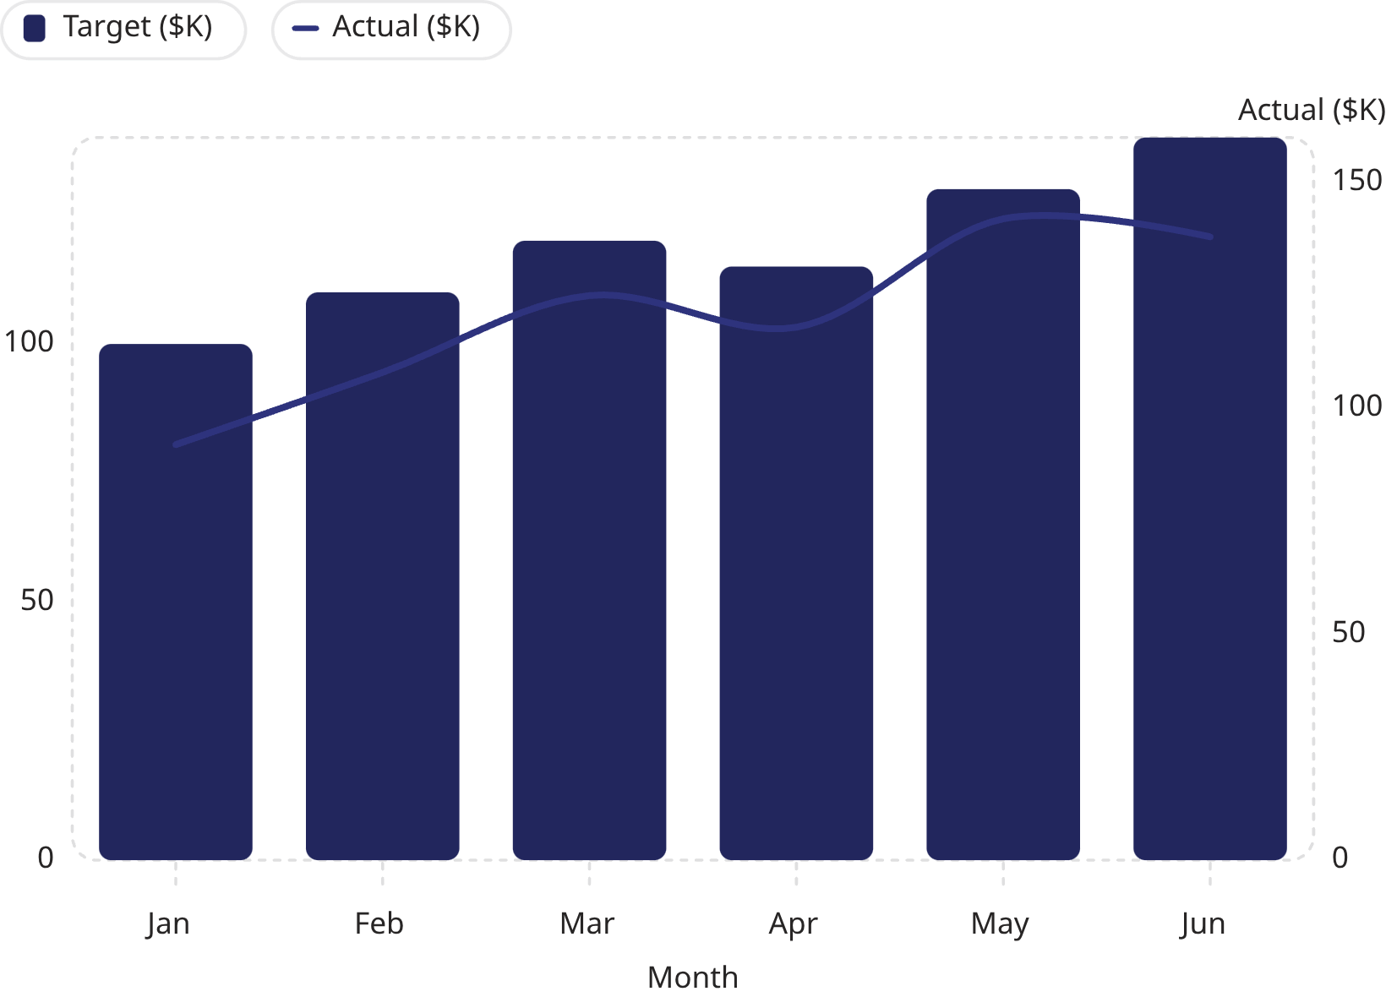
Sales Tracking: Beyond the Sum
Real-Time Projections
Use VLOOKUP or XLOOKUP to pull live sales data into dynamic dashboards — no manual updates required.
Month-to-Date vs. Actuals
Track targets against actuals in a single view, with pivot charts visualizing growth trajectories automatically.

Slide 6
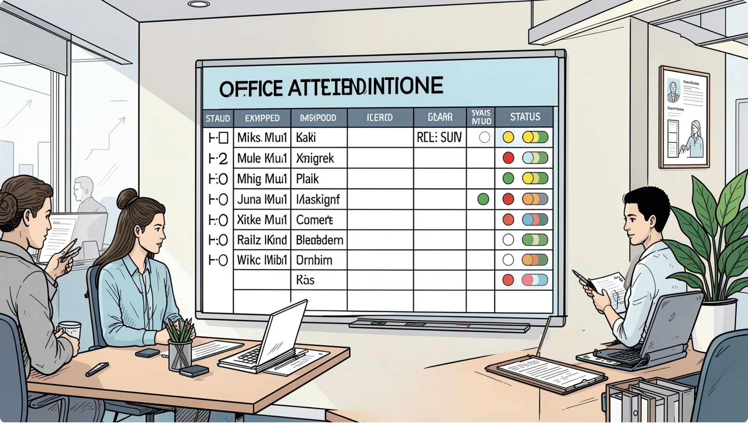
Attendance Monitoring: Precision Matters
01
Automate Logs with COUNTA & COUNTIF
Count present, absent, and late entries automatically from raw check-in data.
02
Identify Absenteeism Trends
Spot recurring patterns before they impact team output and project timelines.
03
Compliance Threshold Alerts
Trigger visual warnings when attendance falls below policy-defined limits.

Slide 7




Automated Decision-Making
Nested IF Statements
Reasonableness Checks
Classify data into multiple tiers — Excellent, Good, Needs Improvement — in a single formula.
Build validation logic that flags outliers and inconsistencies before they reach stakeholders.
Visual Status Updates
Enable data-driven decisions that trigger color-coded status indicators automatically.

Slide 8
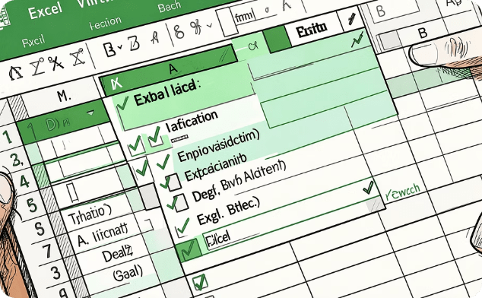
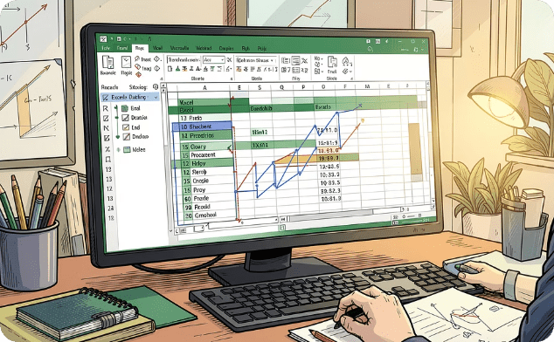

The Toolkit for Every Role
Data Integrity
Efficiency
Security
Use Data Validation and list boxes to prevent entry errors before they happen.
Leverage the Formulas tab to audit, trace, and debug complex calculations with confidence.
Protect sensitive performance and HR data with workbook passwords and sheet-level restrictions.

Slide 9
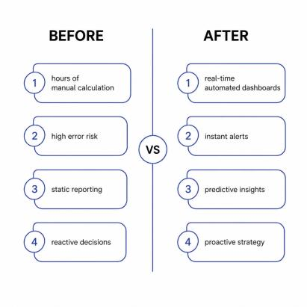

Before & After: The Transformation
Scaling Success
Automation isn't just about saving time — it's about empowering teams to spend less time calculating and more time executing strategy.
Teams that automate reporting reclaim an average of 8+ hours per week for high-value work.

Slide 10


Your Data, Your Strategy
Excel Is Your Swiss Army Knife
From performance scorecards to sales dashboards, the right formula solves the right problem.
Start Small This Week
Automate one process — a performance index, an attendance count, a sales lookup. Build from there.
Turn Data Into Action
The final competitive advantage is the ability to tell a story that leads to decisions.

